Slide 1
Predicting Home Sale Prices in Ames, Iowa
by Andrew Le

Slide 2
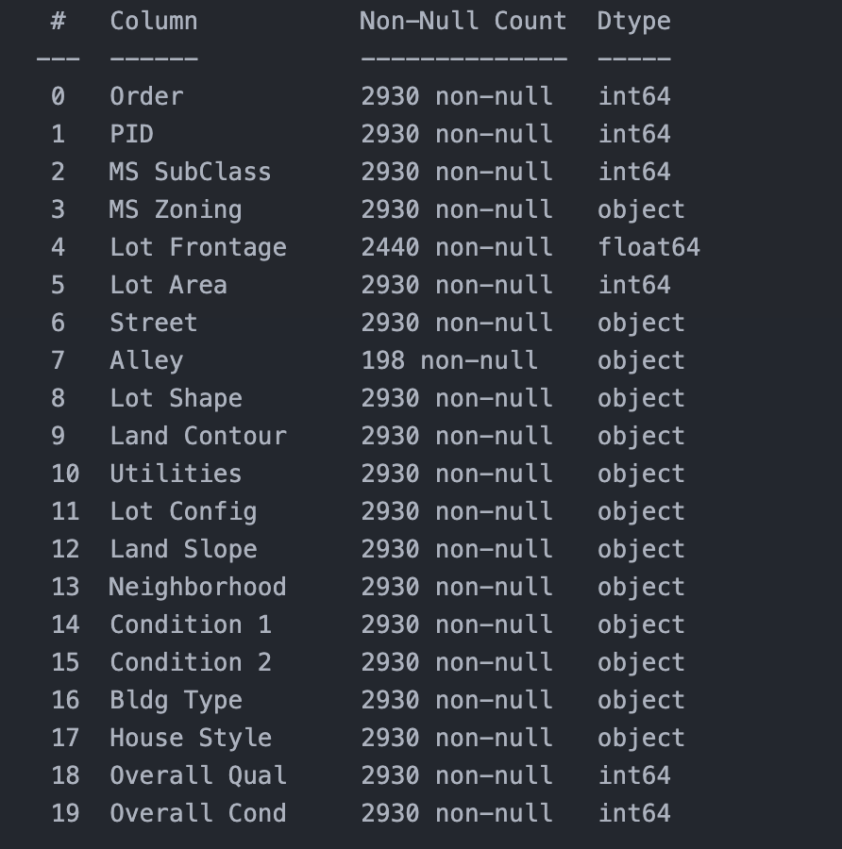
Problem Statement and Motivation
What is the problem? Predicting housing prices accurately
Why it matters: Impact on buyers, sellers, appraisers, and investors
Dataset source: Ames Housing - detailed alternative to Boston Housing dataset
Challenges: Missing data, mixed feature types, nonlinear relationships

Slide 3
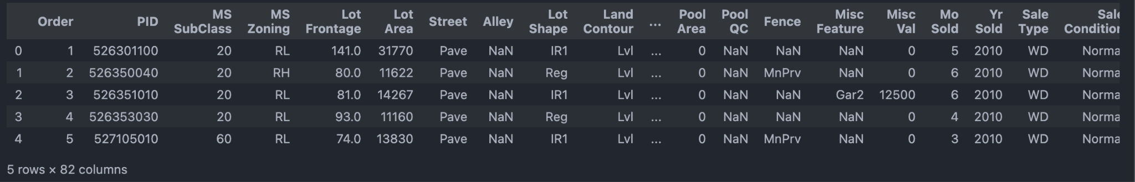
]Data Overview & Description
Dataset contains ~2930 houses and 80+ features
Feature types: Numeric, categorical, ordinal, binary
Examples of key features: Overall Quality, Year Built, Neighborhood, Total Basement SF
Target variable: SalePrice (house price in USD)

Slide 4
Data Cleaning & Missing Data Strategy
Missing values handled carefully:
Dropped columns with >30% missing unless meaningful (Pool QC, Fence)
Imputed numeric missing with median to avoid bias
Imputed categoricals with mode
Filled “None” for sparse but meaningful missing
Why these choices matter for model accuracy and bias

Slide 5
Feature Engineering
Created new features:
TotalSF (sum of basement + 1st and 2nd floor areas) -
HouseAge (age at time of sale)
Remodeled (binary flag if remodeled)
Dropped irrelevant features (PID, Order)
One-hot encoded categoricals for model readiness

Slide 6
Exploratory Data Analysis (EDA) Highlights
Strong positive correlation of TotalSF and Overall Qual with SalePrice
Neighborhood plays a major role — different price ranges by area
Visualized missingness helped decide imputation
Distribution of SalePrice is right-skewed — might consider transformations in future work

Slide 7
Modeling Approaches
Chose three models with increasing complexity:
Linear Regression (interpretable baseline)
Random Forest (handles nonlinearity and interactions)
Gradient Boosting (iterative refinement, state-of-the-art)
Discuss data splitting (80/20) and preprocessing differences

Slide 8
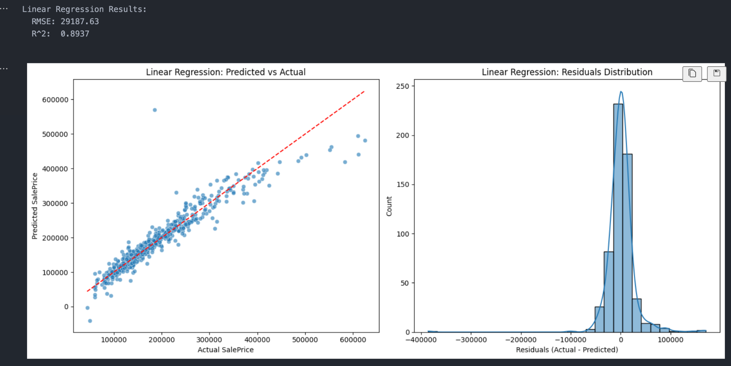

Slide 9
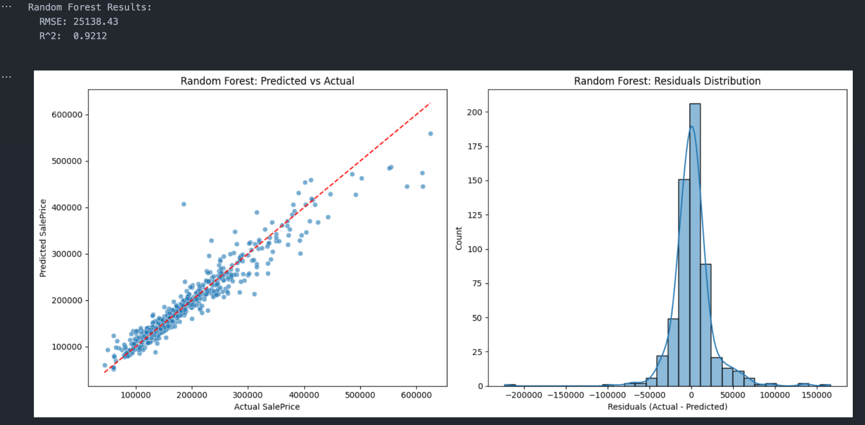

Slide 10
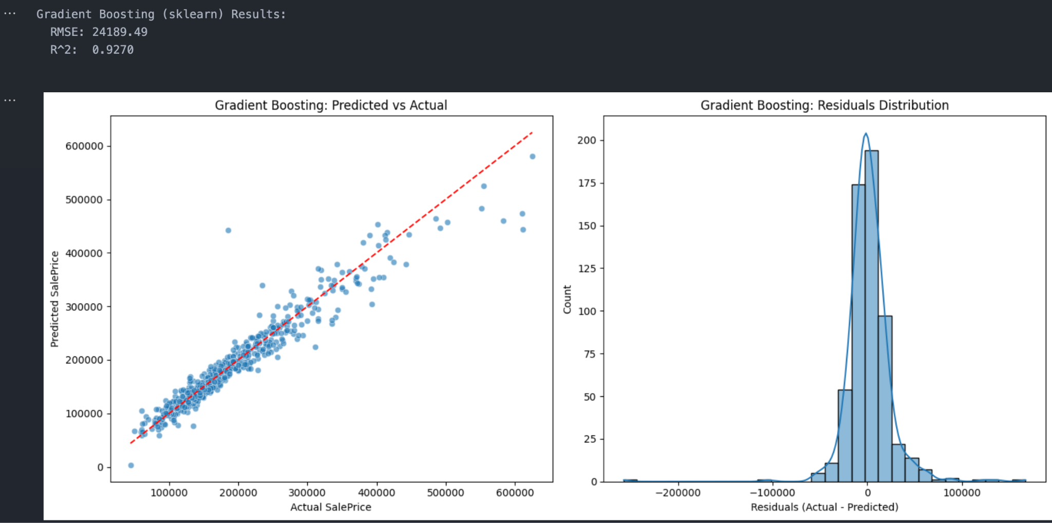

Slide 11
Model Evaluation Metrics
RMSE: measures average prediction error in dollars
R²: explains how much variance the model captures
Models evaluated on test set (never seen during training)

Slide 12
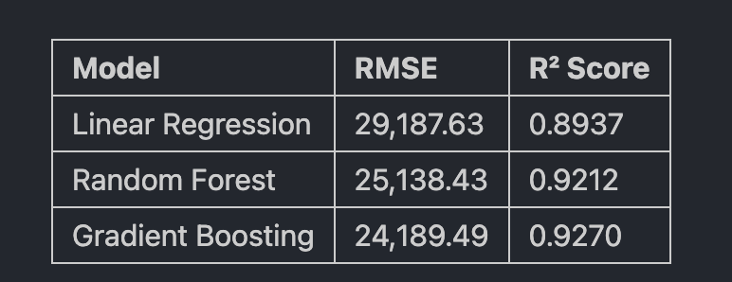
Results
Gradient Boosting best with RMSE ~24,189 and R² ~0.927
Random Forest close behind
Linear Regression decent but limited by linear assumptions

Slide 13
Discussion/Conclusion
Ensemble tree models clearly outperform simple linear regression
Importance of thoughtful data cleaning and feature engineering
Limitations: no hyperparameter tuning, potential for data leakage, skewed target
Future work:
Try transformations (log price), cross-validation
Add interaction terms, advanced models (e.g. LightGBM, CatBoost)
Deploy model in real estate pricing app

Slide 14
Thank you!
Github: https://github.com/letriandrew/ames_housing_price_model
LinkedIn: https://www.linkedin.com/in/letriandrew/

